Slide 1
Characterization of Distributed Systems (Chapter-1)
Distributed Systems - Concepts and Design
(Fourth Edition)
George Coulouris
Jean Dollimore
Tim Kindberg

Slide 2
What is distributed system?
DS is the one in which components located at networked computers communicate and coordinate their actions only by passing messages.
In other words…..
DS consists of a collection of autonomous computers, connected through a network and distributed middleware, which enables computers to coordinate their activities and to share the resources of the system, so that users perceive the system as a single integrated computing facility.
Notes:
Middleware makes application development easier, by providing common programming abstractions, by masking application heterogeneity and the distribution of the underlying hardware and operating systems, and by hiding low-level programming details
Middleware is computer software that connects software components or applications. The software consists of a set of services that allows multiple processes running on one or more machines to interact.
With businesses using so many different software programs to fill their needs, sometimes it's necessary that the different programs work together to get the end results they are looking for. In those situations, middleware is required.
Middleware is considered by many to be a rather vague term in that it is specially designed software that can link two separate applications together. Since this can be used in such a wide variety of ways, it is better understood by discussing some specific examples in how it can be used. One popular example is the middleware that is used to connect a database system with a web server.
This allows a user to request data from a database using forms displayed on a Web browser, according to Webopedia, while also allowing for the Web server to return Web pages based on the user's request.
The term middleware is used to describe separate products that serve as the glue between two applications, Webopedia writes on its website. "Middleware is sometimes called plumbing because it connects two sides of an application and passes data between them."

Slide 3
Continued…
These definitions lead to the following characteristics of distributed systems:
Concurrency
No global clock
Independent failures of components

Slide 4
Consequences of Distributed Systems
Concurrency
Multiple activities executed at the same time.
E.g. a server may create two threads running concurrently to service two client requests.
No global clock
Programs cooperate not by any shared idea of time but by passing messages
Thus there is no single global notion of time.
Independent failures
Each component of a distributed system can fail independently, leaving the others still running .

Slide 5
EXAMPLES OF DISTRIBUTED SYSTEMS:
Internet/World-Wide Web
Local Area Network and Intranet
Mobile Computing and Ubiquitous Computing
Database Management System
Automatic Teller Machine Network

Slide 6
EXAMPLES OF DISTRIBUTED SYSTEMS:
Internet/World-Wide Web
intranet
%
ISP
%
%
%
backbone
satellite link
desktop computer:
server:
network link:
Notes:
Internet is the largest distributed system in the world.

Slide 7
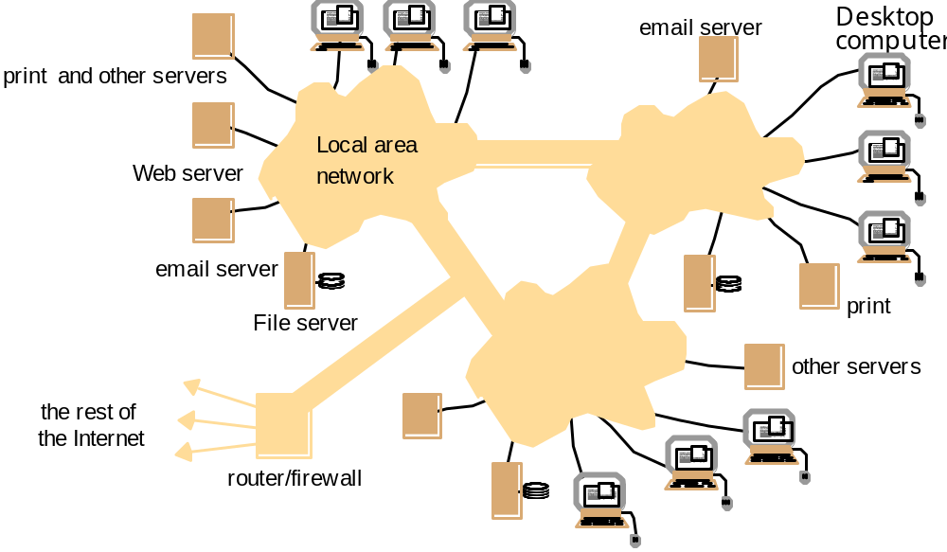
EXAMPLES OF DISTRIBUTED SYSTEMS:
Local Area Network and Intranet
Notes:
A local area network consists of a number of different computers. Workstations and Personal computers provide the front-end for network users. Different servers provide shared services.
One or several network file servers provide data storage services. Any workstation and PC may henceforth store files on disks maintained by these file servers.
A local name server maps machine names to IP addresses, user names to user ids and group names to group ids. Any machine can request a service to resolve a certain name.
One or several print servers control the access to shared printers.Workstations and PCs have the server printing jobs for them.
Another component provides a gateway to the wide area network.
As a user you need not be aware which machine provides which service.
Name servers provide the information regarding machine (by IP address), user names (by user ids), and group name (by group ids).
Local area networks can be connected together to form Intranets.

Slide 8
EXAMPLES OF DISTRIBUTED SYSTEMS:
Mobile and Ubiquitous Computing
Internet
Host intranet
GSM/GPRS
Home intranet
Wireless LAN
gateway
Mobile
phone
Printer
Laptop
Camera
Host site
Notes:
Mobile and ubiquitous computer extend the access of Internet and distributed system architecture from wire-line connections to wireless connections.
General Packet Radio Services (GPRS) is a packet-based wireless communication service that promises data rates from 56 up to 114 Kbps and continuous connection to the Internet for mobile phone and computer users. The higher data rates allow users to take part in video conferences and interact with multimedia Web sites and similar applications using mobile handheld devices as well as notebook computers. GPRS is based on Global System for Mobile (GSM) communication and complements existing services such circuit-switched cellular phone connections and the Short Message Service (SMS).
Download thi

Slide 9
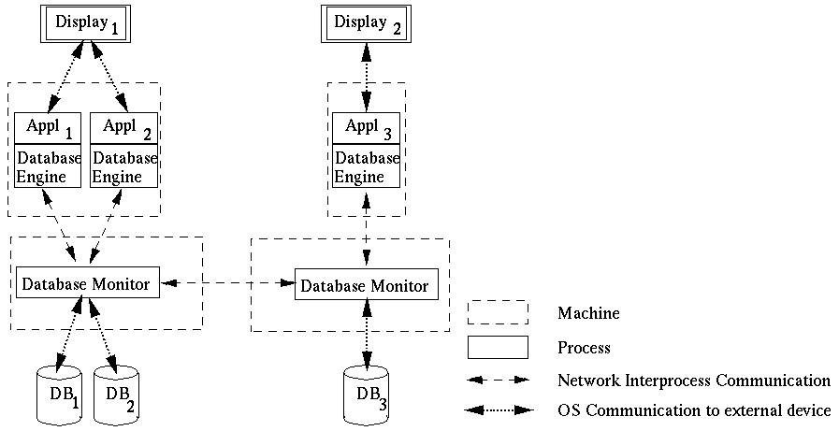
EXAMPLES OF DISTRIBUTED SYSTEMS:
Database Management System
Notes:
Different client applications want to access and update shared data in a database.
Client applications might be banking systems, real-estate agencies, airline-ticket reservation systems accessing data like balances of bank accounts, details of property that are for sale or to let, or airfares and aircraft reservation data.
The database is physically distributed over several processors to take advantage of local data accesses for increased performance of client applications.
Data may be replicated to reduce the impact of failures of a processor and/or the network.
Each processor runs a database monitor that implements the mapping between the database seen by clients and the physical database stored on the different processors.
Database monitors have to cooperate with each other to implement client accesses to remote data, updates of replicated data and concurrency control.
The physical distribution of data is therefore transparent to clients.

Slide 10
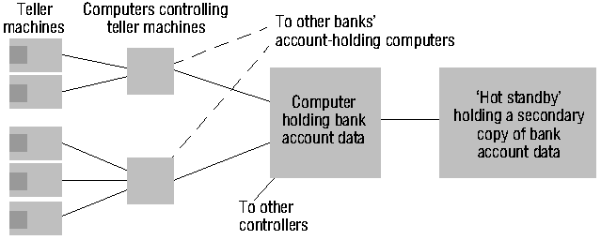
EXAMPLES OF DISTRIBUTED SYSTEMS:
Automatic Teller Machine Network
Notes:
An automatic teller machine network enables bank customers to withdraw cash from their bank account.
Banks and building societies maintain large networks of teller machines.
Customer have high security, privacy and reliability requirements.
Customers may want to withdraw cash from their account through a ´foreign´ teller machine.
A front-end computer controls one or several tellers. It
transfers withdrawal requests to the computer of the account holder´s bank,
awaits the bank granting the request, and
therefore has to be interoperable with heterogeneous computer systems (Hang Seng Bank may have different account management systems than HongKong Bank and Bank of China).
Each bank has fault-tolerant systems to quickly recover from failures of their account holding computers. An example is the ´Hot standby´ computer which maintains a copy of the account database and can replace the main computer within seconds.

Slide 11
CHALLENGES:
  Heterogeneity
  Openness
  Security
  Scalability
  Failure handling
  Concurrency
  Transparency
Notes:
Why do we bother about constructing distributed systems? Constructing a centralized system appears to be much easier!
Some properties of a distributed system cannot be achieved by a centralized system. It is worthwhile to keep these properties in mind during the design or assessment of a distributed system.
Heterogeneity: I can access all the documents that are available on the Internet, even though the documents are located in different type of machines.
Openness: I have credit cards from Hang Seng Bank and Wells Fargo Bank in U.S.A. and can use them at each others tellers. These banks, however, would never develop a common centralized teller system. It is because their systems are open and interoperable that I have this flexibility.
Security: I want to purchase products in e-Commerce. I don’t want other people to steal my credit card number.
Scalability: Distributed systems, such as the Internet, grow each day to accommodate more users and to withstand higher load. (Hong Kong stock trading broker is on-line and you can open accounts and do on-line trading from home PC).
Failure Handling: Two (distributed) account databases are managed by the bank to quickly recover from a break-down.
Concurrency: Multiple database users can concurrently access and update data in a distributed database system. The database system preserves integrity against concurrent updates and users perceive the database as their own copy. They are, however, able to see each others changes after they have been completed.
Transparency: When using a distributed system it appears to users as if it were centralized.

Slide 12
Heterogeneity applies to
  Network
  Computer Hardware
  Operating Systems
  Programing Language
  Implementations by different developer
Middleware as software layers to provide a programming abstraction as well as masking the heterogeneity of the underlying networks, hardware, OS, and programming languages (e.g., CORBA).
Some of the uniform computational models provided by middleware are remote Object Invocation, Remote event Notification, Remote SQL Access, Distributed Transaction Processing.
Mobile code – Virtual Machine approach helps to execute the code on any hardware….
Notes:
The Internet enables users to access services and run applications over a heterogeneous collection of computers and networks.
Heterogeneity applies to
Networks
Computer hardware
Operating systems
Programming languages
Implementations by different developers
Differences of heterogeneous components in a distributed system have to be resolved
Differences in data type representation regarding, for example, byte ordering of integers
Different APIs of different operating systems for the implementation of the Internet protocols
Different programming languages use different representations for characters and data structures such as arrays and records
Different programmers have to common standards for communication purpose
Middleware helps to solve the problems of heterogeneity. It also provides a uniform computational model for use by the programmers of servers and distributed applications.
Mobile code is used to be run on heterogeneous computers. To get it done, the virtual machine approach provides a way of making code executable on any hardware: the compiler for a particular language generates code for a virtual machine instead of a particular hardware order code.

Slide 13
Openness in H/w and S/w:
Openness is concerned with extensions and improvements of distributed systems.
H/w level : addition of computers to n/w.
S/w level : Introducing new services , reimplementation of old ones, enabling application programs to share resources.

Slide 14
Security – 3 Components
Security for information resources has 3 components
Confidentiality(protection against unauthorized individuals)
  In a distributed system, clients send requests to access data managed by servers, resources in the networks:
  Doctors requesting records from hospitals
  Users purchase products through electronic commerce
Integrity (protection against alteration or corruption)
  Security is required for:
  Concealing the contents of messages: security and privacy
  Identifying a remote user or other agent correctly (authentication)
Availability (protection against interference while accessing the resources ie. Systems and data are usable when needed…)
  New challenges:
  Denial of service attack
  Security of mobile code

Slide 15
Scalability
A system is described as scalable if it remain effective , when there is a significant increase in no. of resources and no. of users.
Design of scalable DS presents following challenges:
Controlling the cost of physical resources
Controlling Performance Loss
Preventing s/w resources running out
Avoiding performance bottlenecks.
Notes:
Centralized systems often create bottlenecks as soon as a certain number of users are reached.
Distributed systems can be built in a way that these bottlenecks are avoided.
Then new processors can be added to accommodate new users. The Internet grows every day by adding new sites.
Other internet sites are not affected by these additions. They do not have to be changed.
However, components in distributed systems have to be designed in a way that the overall system remains scalable.
Sometimes it is required to relocate components, i.e. to migrate them to new processors. Relocation is required to populate new processors with components and to remove a certain amount of load from existing processors.
Then it is important that no or only very little assumptions are made on the location of components, both within the component itself and also within other components that use the component. Otherwise these components having explicit location information have to be changed whenever a component is relocated.

Slide 16
Failure Handling
In DS failure is partial
Techniques for dealing with failures:
Detecting Failures – (Eg. Checksum)
Masking Failures – (Eg. retransmitting msgs)
Tolerating Failures – (Eg. Error Msg web browser cannot contact web server)
Recovery from failures
Redundancy
Notes:
Hardware, software and networks are not free of failures. They fail either because of software errors, failures in the supporting infrastructure (power-supply or air-conditioning), mis-use of their users or just because of aging hardware. The average life time of hard disks are between two and five years, much less than the average life-time of a distributed system.
Given that there are many processors in a distributed system, it is much more likely that one of them fails than it is that a centralized system fails.
Distributed system, therefore, have to be built in a way that they continue to operate, even in the presence of failures of some of its components.
A distributed system can even achieve a higher reliability than a centralized system if distribution and replication is exploited properly.
Two different means have to be deployed to achieve fault tolerance: recovery and redundancy.
Components that are able to recover from failures have been built in a way that they react in a controlled way if they rely on services of components that have failed.
Redundant hardware, software and data decreases the time that is needed after a failure to bring a system up again.

Slide 17
Concurrency
Resource sharing is the main motivation of DS.
These resources are shared by clients
Several clients will attempt to access a shared resources at the same time
If it takes one client request at a time it limits throughput.
It allows multiple clients request to be processed concurrently.
Integrity of the system may be violated if concurrent updates are not coordinated.
  Lost updates
  Inconsistent analysis
Notes:
Components in distributed systems are executed concurrently. There may be many different people at different teller machines. Likewise, there are many different users working in a local area network.
While these components access shared resources, the resources have to be protected against integrity violations that may be introduced through concurrency.
As an example for a lost update, consider that you withdraw 50 dollars. This requires the bank´s account database to compute:
debitbalance = balance-50; /* Op1 */
balance = debitbalance; /* Op2 */
If a clerk in the bank credits a check of 100 dollars the following computation has to be done:
creditbalance = balance+100; /* Op3 */
balance = creditbalance; /* Op4 */
If these two modifications to your account are done concurrently the integrity of the account data may be violated in two ways:
1. your debit may not be recorded (bad luck for the bank) if the schedule is (Op1, Op3, Op2, Op4).
2. the credit of your check may not be recorded (bad luck for you) if the schedule is (Op3, Op1, Op4, Op2).
These situations have by all means to be avoided.
Concurrency control facilities (such as locking) are needed in almost any concurrent system.

Slide 18
Transparency
Access Transparency
Location transparency -
Concurrency Transparency
Replication Tranparency
Failure Transparency
Mobility Transparency
Performance Transparency
Scaling Transparecy
Most important transparencies are Access and Location transparencies(called as network transparency)

Slide 19
Access Transparency
Enables local and remote information objects to be accessed using identical operations.
Example: File system operations in NFS.
Example: Navigation in the Web.
Notes:
Access transparency means that the operations or commands that are used for accessing objects are identical irregardless whether local or remote data is being accessed.
Examples of access transparency are:
Users of UNIX NFS can use the same commands for copying, moving and deleting files irregardless whether the accessed files are local or remote.
Application programmers can use the same library calls to manipulate files on NFS.
Users of a web browser can navigate to another page by clicking on a hyperlink, irregardless whether the hyperlink leads to a local or a remote page.
Programmers of a database application can use the same SQL commands irregardless whether they are accessing a local or a remote database in a distributed relational database management system.

Slide 20
Location Transparency
Enables information objects to be accessed without knowledge of their location.
Notes:
Location transparency means that data can be accessed without knowing the physical position of the data.
Examples
Users of the network file system can access files by name and do not need to know whether the file resides on a local or a remote disk.
The same applies to application programmers, who can pass file names to library functions and need not worry about the physical location of the files.
Users of a Web browser need not be aware where the page physically resides. They can access initially pages by a URL and then can navigate further by URLs that are embedded in the web page.
Programmers of a relational database application do not need to worry where the tables physically reside. They can access tables by table name and need not worry about where the table is physically located. Their local database monitor will translate the names into physical location and have remote monitors transferring tables if a remote table should be accessed.

Slide 21
Concurrency Transparency
Enables several processes to operate concurrently using shared information objects without interference between them.
Example: Automatic teller machine network
Notes:
Enables several processes to concurrently access and update shared information without having to be aware that other processes may be accessing the information at the same time.
Examples:
Multiple users can access and update files on the same file system and they do not know about each other.
Concurrency is, however, not transparent for an application programmer using the file system. To avoid lost updates and inconsistent analysis, s/he has to explicitly lock files.
Users of an automatic teller machine need not be aware of the fact that other customers are using tellers at the same time and that bank clerks may be concurrently manipulating account balances.
Programmers of relational database applications typically need not worry about concurrency, but integrity against concurrent updates is typically preserved by the database management system (e.g. by two-phase locking).

Slide 22
Replication Transparency
Enables multiple instances of information objects to be used to increase reliability and performance without knowledge of the replicas by users or application programs
Example: Distributed DBMS
Notes:
Replication is the duplication of data on other hosts
Replication is used to increase the reliability of data accesses as well as the performance with which data is accessed and updated.
Replication transparency denotes the fact that neither users nor application programmers have to be aware about the replication of data.
Examples:
Tables in a distributed relational database may be replicated. However neither users, nor application programmers are aware that the tables are replicated and updates have to be propagated to the other replicas as well.
Often Web pages are replicated to increase performance of their retrieval and to have them available also in the presence of network failures. The SuperJanet gateway, for instance replicates pages from the US that are frequently accessed. Replication, however, is transparent for both Web surfers and Web page designers. A Web surfer does not see that the page is not being brought over the Atlantic (S/he may be surprised by the speed, however). A Web page designer can still refer to the US URL and need not take the mirror site into account.

Slide 23
Failure Transparency
Enables the concealment of faults
Allows users and applications to complete their tasks despite the failure of other components.
Example: Database Management System
Notes:
Even though components in distributed systems may fail, it is important that users of the systems are not aware of these failures. Failure Transparency denotes this concealment of failures.
Failure transparency is rather difficult to achieve. It involves complete fault recovery.
As an example, consider the distributed database again. If the database has kept local replicates of remote data, users can continue to use the database, even though the remote data monitors have failed. The local data monitor has to detect the failure of remote monitors. Updates of local data then have to be buffered in the local replicate, inconsistencies have to be temporarily tolerated (as multiple sites may temporarily buffer updates). After the remote monitor has come up again, the buffered updates have to be incorporated into the remote databases and inconsistencies (if any) have to be reconciled.

Slide 24
Mobility Transparency
Allows the movement of information objects within a system without affecting the operations of users or application programs
Example: Web Pages
Notes:
Migration denotes the fact that software and/or data is moved to other processors.
Migration is transparent to users and application programmers if they do not have to be aware of the fact that software and/or data has moved.
Migration transparency is dependent on location transparency.
Examples:
If CSE decides to move file systems of the NFS (or parts thereof) to a different disk, you will not recognize that.
If CSE moves the department Web site to a different location in the file system, you will not recognize that because the URL http://www.cse.cuhk.edu.hk will be interpreted by the local http daemon.

Slide 25
Performance Transparency
Allows the system to be reconfigured to improve performance as loads vary.
Notes:
Performance Transparency denotes the fact that users and application programmers are not aware as to how the performance that a distributes system has is actually achieved.
Example: There is a variant of make that is capable of performing jobs (e.g. compiling a source module) on remote machines. Then complex systems can be compiled much quicker. It not only considers the different processors and their capabilities, but also their actual load. If it can choose from a set of processors, it will delegate it to the fastest processor that has the lowest load. In this way it achieves an even better performance. Programmers using make, however, do not see or choose which machine performs which job. The way how the actual performance is achieved is transparent for them.

Slide 26
Scaling Transparency
Allows the system and applications to expand in scale without change to the system structure or the application algorithms.
Example: World-Wide-Web
Notes:
Scalability denotes the fact that the distributed system can be adjusted to accommodate a growing load / number of users.
Scaling the distributed system up is transparent if users and application programmers do not have to be changed.
Examples:
New Web sites can be added to the Internet, thus scaling the Internet up without existing sites having to change their set-up.
New network connections can be added in the Internet or existing connections are replaced with higher bandwidth connections to improve throughput. Existing Web sites do not have to be changed to benefit from this improvement.
In a distributed database, new hosts can be added to accommodate parts of the database. The allocation tables maintained by database monitors will have to be adjusted. Existing database schemas and applications, however, need not be changed.

